Slide 1
Lesson objective
Need whiteboards and calculators.
Title: Topic review
Aim – be able to:
Solve 2-step equations using the balancing method
Verify solutions
Plan:
Warm-up equations
Best buy and percent review
Equations

Slide 2
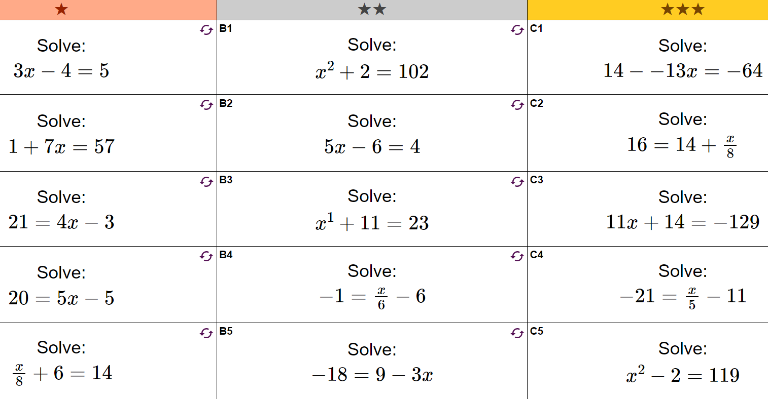

Slide 3
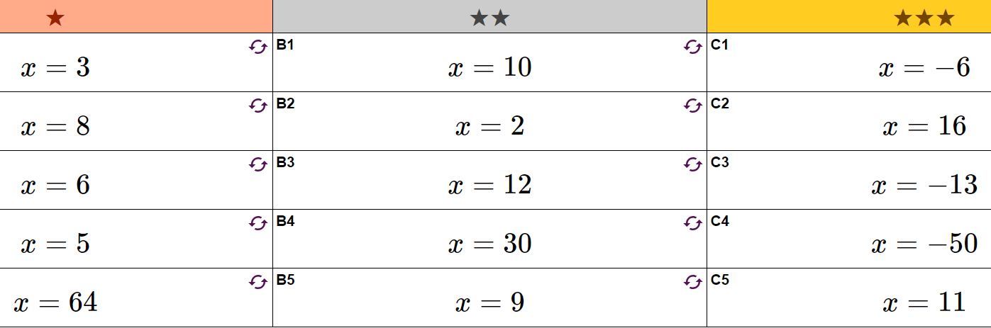

Slide 4
Is the solution correct…..
To Verify a solution, we substitute a value and solve.
Is n = 5 a solution to….
N + 8 = 13
2n + 11 = 19
10 – 2n = 0
3n + 15 = 45 – 3n

Slide 5

I do
Verify if n = 6 for the equation:
$$3n −9=9$$

Slide 6

Whiteboards
Is x = 5 a solution? Verify on whiteboards
$\frac{3x}{5}+8=11$
$28−3x=7$

Slide 7
Whiteboards
Convert percent to decimal
Change OF to multiplication
Multiply decimal to amount
30 % of 560L
21% of 87m
92% of $70
400% of 58cm
2.5% of 320mm

Slide 8
You do – exercise books
Convert to Kg price
Convert to 100g price
$2 per 100g
$0.54 per 100g
$0.45 per 100g
$5.17 per 100g
$2.10 per 200g
$13.50 per kilo
$18 per kilo
$22.70 per kilo
$3.50 per kilo
$15 for 2 kilo

Slide 9
Brain break

Slide 10
Yesterday’s work review
Find yesterday’s “mixed questions”

Slide 11
Mixed practice
2x + 10 = 7x + 5
3x + 9 = 6x
3 (x + 4) = 6x
8y - 6 = 2(y + 9)
3(a + 4) = 5 (a + 2)
3x - 8 = x + 2
2x + 12 = 6x
5 + 3x = 9x – 4
2 (a + 5) = 6 ( a – 5)
5 (y – 6) = 2 ( 6 + y)
4b = 6b - 12
x = 1
x = 3
x = 4
y = 4
a = 1
x = 5
x = 3
x = 1.5
a = 10
y = 14
b = 6
Start next page
“problem solving”
Skip question 2

Slide 12
Problem solving and reasoning
ABCD is a parallelogram.
Find the size of angle y°.
Here is part of a drawing of a regular polygon.
It shows two of the interior angles of the regular polygon.
How many sides does the regular polygon have?
C
D
y°
(5x − 10)°
(6x − 70)°
(4x + 10)°
(3x + 50)°
y°
B
A
6x − 70 = 4x + 10
6x − 4x = 10 + 70
2x = 80
x = 80 ÷ 2
x = 40
Each angle is 170°, if x = 40;
Exterior angles give
360 ÷ (180 − 170) = 36 sides.
5x − 10 = 3x + 50
5x − 3x = 50 + 10
2x = 60
x = 60 ÷ 2
x = 30
5x − 10 = 3x + 50
= 140 when x = 30
y = (360 − 140 − 140) ÷ 2
y = 40

Slide 13
Problem solving and reasoning
A
ABC is an isosceles triangle.
Find the value of a.
Find the length AB.
2a + 6
5a - 3
a)
2a + 6 =
5a - 3
- 2a
- 2a
6 = 3a - 3
+ 3
+ 3
C
B
9 = 3a
÷ 3
÷ 3
3 = a

Slide 14
Problem solving and reasoning
A
ABC is an isosceles triangle.
Find the value of a.
Find the length AB.
2a + 6
5a - 3
b)
AB = 2a + 6
a = 3
AB = 2x3 + 6
B
C
AB = 6 + 6
AB = 12 units

Slide 15
Problem solving and reasoning
Carl thinks of a number. He multiplies this by 3 then adds 23.
Liz thinks of a number and she adds 3, then she multiplies this by 5.
The number they chose and sums at the end are equal. What is the number they have picked?
They think of the same number to start with, lets say x.
Carl’s expression => 3x + 23
Liz’s expression => 5(x + 3)
3x + 23 = 5(x + 3)
3x + 23 = 5x + 15
23 = 2x + 15
8 = 2x
4 = x They thought of number 4.

